Slide 1

Real-Time Chat Server
Building a robust and scalable real-time chat backend for instant communication.

Slide 2

Our Solution: WebSocket Technology
Persistent Connection
Efficient Resource Use
WebSockets establish a long-lived, bidirectional communication channel.
WebSockets reduce server load and network traffic.
1
2
3
Real-Time Messaging
Data can be sent instantly in both directions.
1
Instant Notifications
2
Scalable Architecture
Users receive updates as they happen.
WebSockets enable efficient real-time communication.
3
Reduced Latency
The persistent connection minimizes response time.

Slide 3

Our Solution: WebSocket Technology
Persistent Connection
Reduced Overhead
Full-duplex communication over a single TCP connection.
Efficient data transfer minimizes bandwidth usage.
Scalable Architecture
Low Latency
Designed to handle multiple concurrent users and chat rooms.
Instant message exchange without repetitive handshakes.

Slide 4
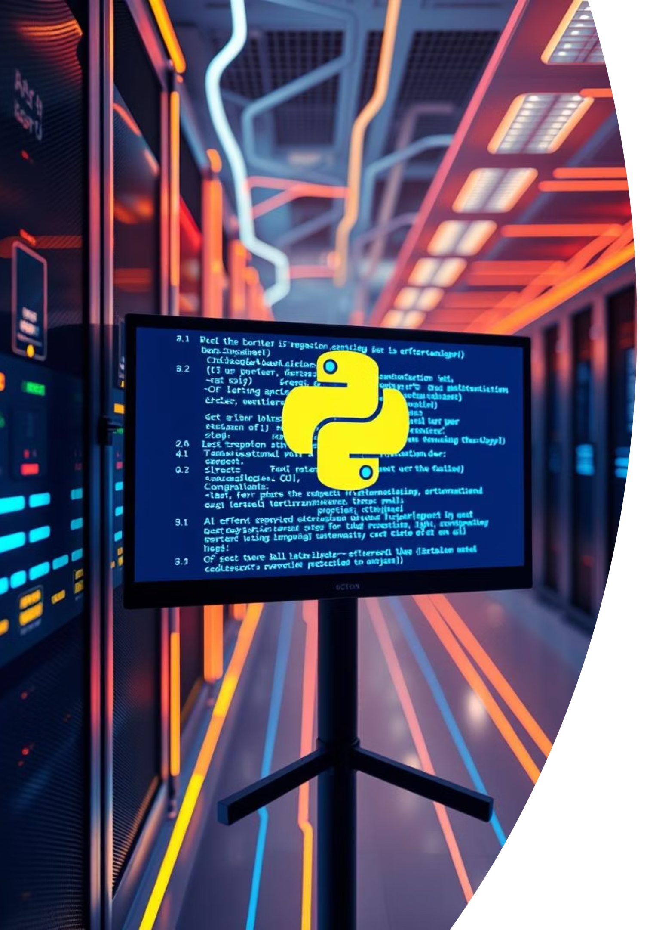



Python Backend: FastAPI & WebSockets
FastAPI Framework
Uvicorn ASGI Server
Asynchronous capabilities for high performance and concurrency.
Efficiently handles WebSocket connections and requests.
Redis Integration
Pub/Sub for message broadcasting across chat rooms.

Slide 5


Multi-Room Chat: The Wow Factor
Our server supports multiple isolated chat rooms, enabling distinct conversations without interference. This allows for:
Segmented Discussions
Users can join specific topics or groups.
Enhanced Organization
Keeps conversations focused and manageable.
Improved User Experience
Tailored interaction for diverse needs.

Slide 6






Target End Users
Education
Virtual classrooms, study groups, student-teacher interactions.
Enterprise
Internal team collaboration, project management discussions.
Community Platforms
Forums, social networks, interest-based groups.

Slide 7
RESULT

Slide 8

Future Enhancements & Conclusion
Future Scope
Conclusion
End-to-end encryption for enhanced security.
Our Python-based WebSocket server delivers a highly efficient, scalable, and user-friendly real-time chat experience, ready to power modern communication platforms.
Integration with third-party authentication services.
Persistent message history and archival.
Voice and video call integration.

